Slide 1
COMP7033 Coursework
Oxford Brookes University
Presented By: Simran Kaur
Email Id: 19277068@brookes.ac.uk

Slide 2
Teacher Module
Requirements delivered:
FR-TE-1: Set up exercises and assessment. The system should enable the teachers to setup online and offline exercises and assessments for his/her students of a class.
FR-TE-2: Mark student works. The system should enable the teachers to mark online and offline exercises and assessments, and to give marks and feedback to the students.
FR-TE-3: Upload teaching material. The system should enable teachers to upload teaching materials to the system, for example, lecture slides, reading lists, and documents to read, links to online e-books, etc.
FR-TE-4: Manage classes. The system should enable a teacher to view the list of students on his/her class, to add students to a class, and to remove students from a class.

Slide 3
Technologies Implemented
Python FastAPI framework
MongoDB
AWS Lambda computing platform

Slide 4
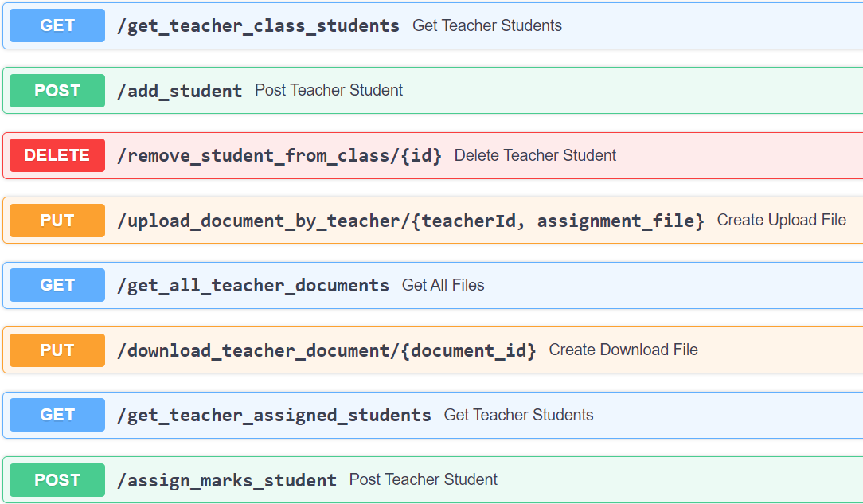
Teacher module API’s
List of API’s using FastAPI swagger GUI SS:

Slide 5
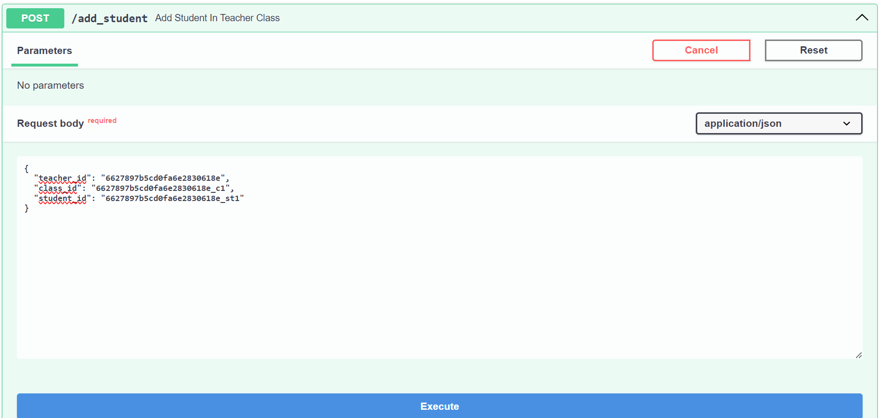
Add student in teacher class API
FR-TE-4

Slide 6
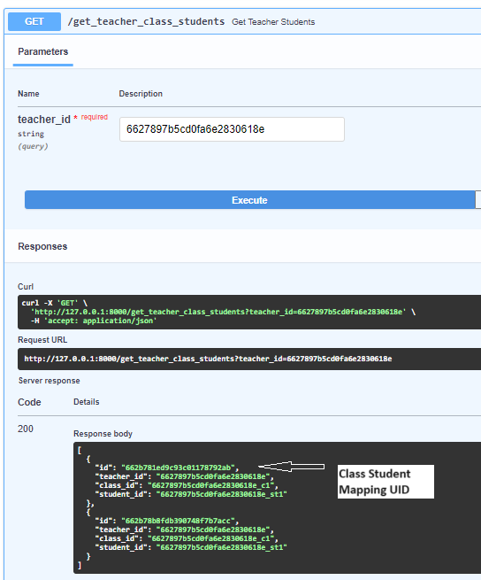
Get all teacher’s students list API
FR-TE-4

Slide 7
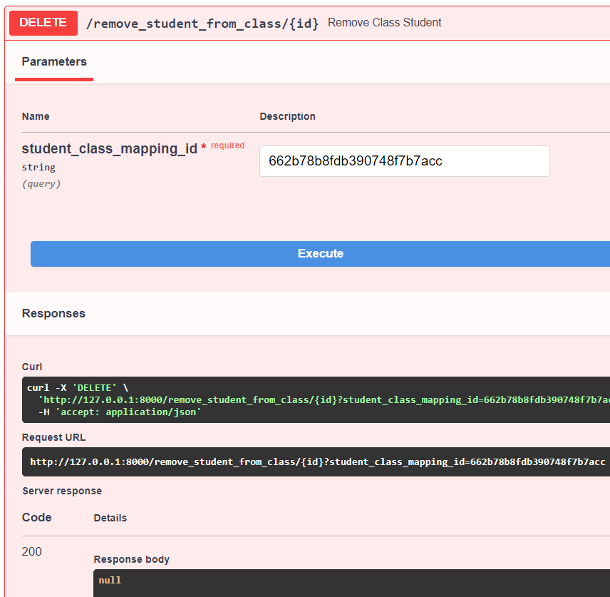
Remove Class Student API – step-1
student_class_mapping_id - recieved from previous slide
FR-TE-4

Slide 8
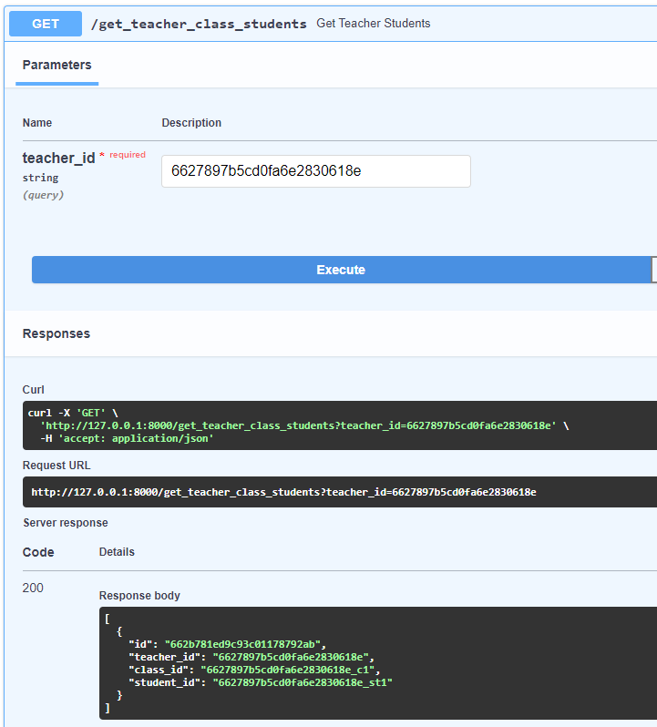
Remove Class Student API – step-2
Updated list of Teacher’s class students:
FR-TE-4

Slide 9
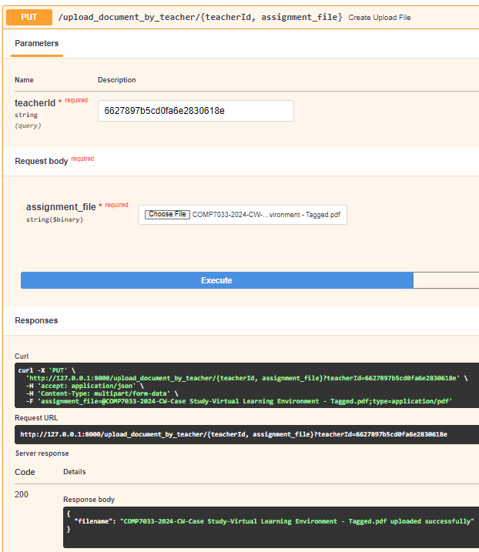
Upload Teaching Material API
Teacher is enabled to upload document of any type such as: .ppt, .doc, .ppt, .pptx etc
FR-TE-3

Slide 10
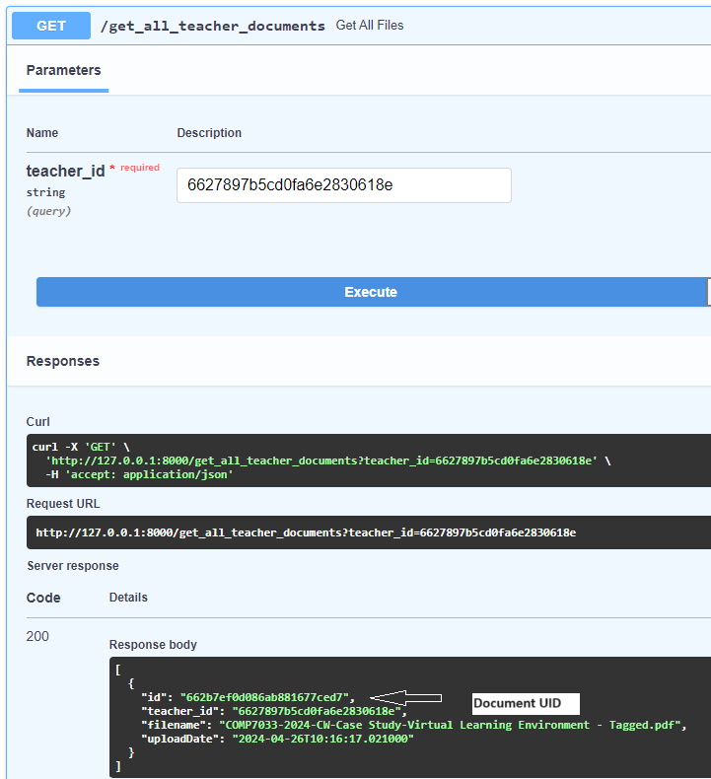
Get Teaching Material List API
FR-TE-3

Slide 11
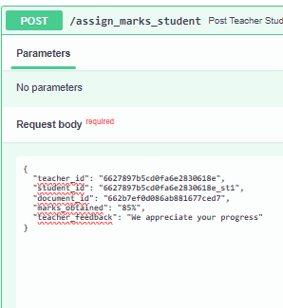
Marks & Feedback to Student Work
FR-TE-1 & FR-TE-2

Slide 12
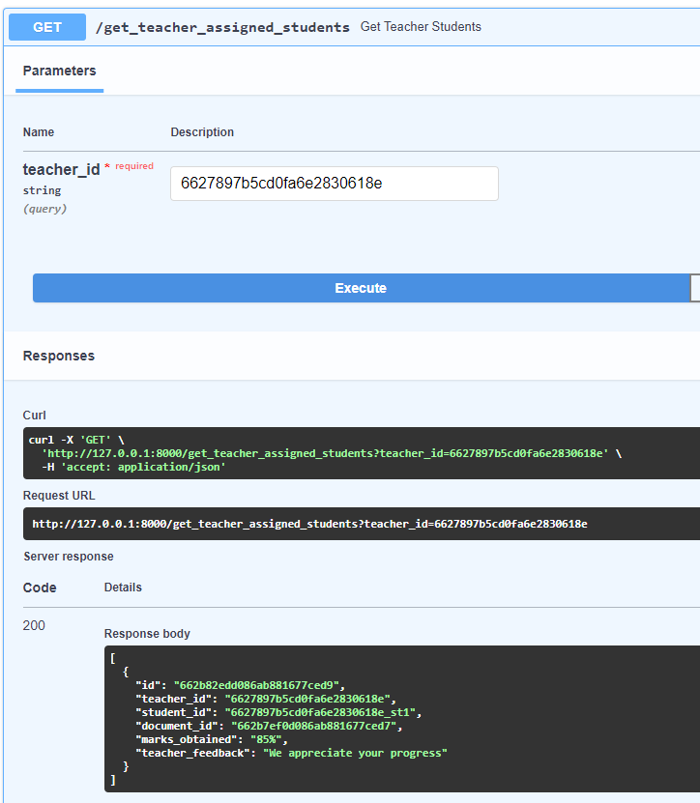
List of student assigned documents
FR-TE-1

